Slide 1
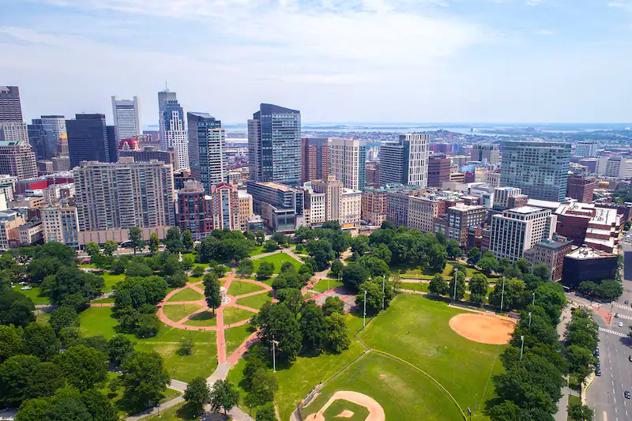
Gun Violence
Gun Violence - Team 3
Team Members:
Sarah Bonna (Team Lead),
Brian Mahabir,
Shivangi,
Showndarya Madhavan

Slide 2
Gun Violence
Project motivation:
Recent uptick in gun possession among youth in Boston's District 4
Need to understand the drivers of gun violence in the district and the city as a whole.
Inform policies that can improve the district and reduce the incidence of gun violence.

Slide 3
Gun Violence
Project Goal
To understand the drivers of gun violence in Boston's District 4 and the city as a whole, with a focus on identifying the variables associated with increases or decreases in gun violence.

Slide 4
Gun Violence
Project Background
To understand the project, it would be helpful to have knowledge of the factors that contribute to gun violence, such as poverty, access to firearms, mental health, and social dynamics.
Familiarity with the existing programs designed to address gun violence, their effectiveness, and their limitations would also be useful.

Slide 5
Project Extension Proposal
Rationale
To highlight potential important environmental trends which can pave the way for approvals for redesigning areas of Boston
Hypothesis
Greener environments have less violence than desolate urban settings.
More gun violence incidents closer to community centers.
More details found here:
Extension Proposal

Slide 6
Progress so far
Datasets used/to be used
Gun Violence
City Council Dataset
Shots Fired
Shootings
Community Centers
Parks
Tree Canopy
Conservation & Recreations
Explored the Community Centers dataset
Focused on Community Centers dataset to create mappings to City Council Districts

Slide 7
Next steps
Questions/Obstacles
Analyze the Parks, Tree Canopy, Conservations & Recreation datasets as mentioned in the extension proposal
Look at the correlation between number of Community Centers and Parks with number of shootings in each city council district
Productivity decrease due to mid-semester competition

Slide 8
Questions?
Gun Violence

